Slide 1

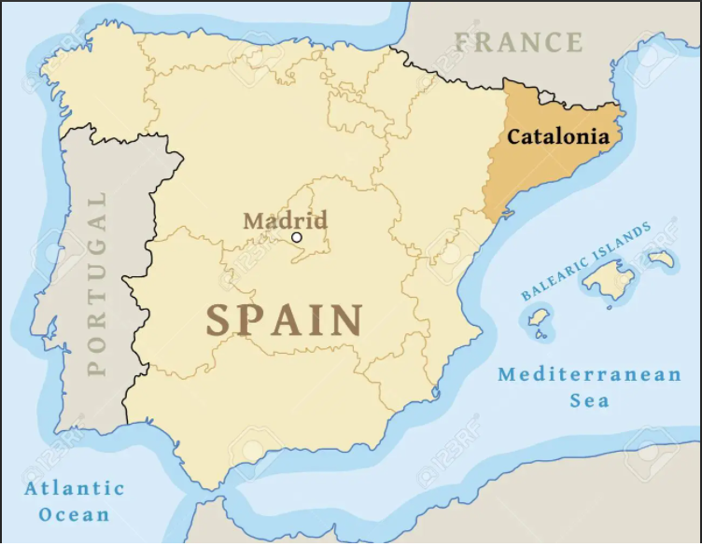
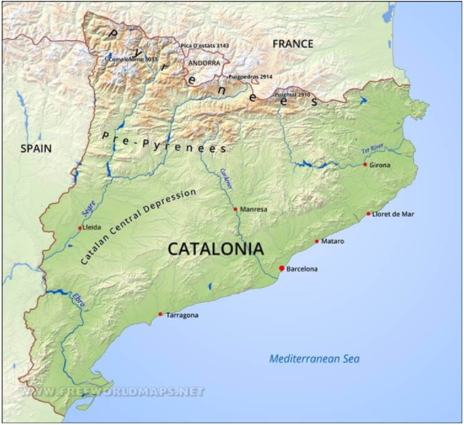
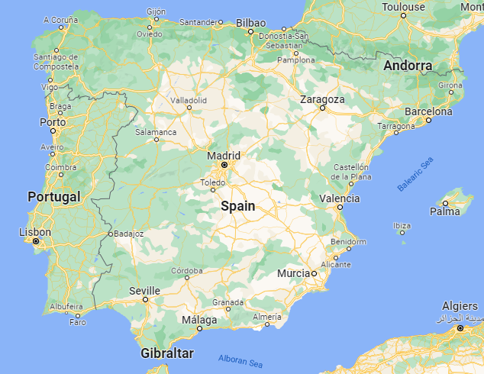
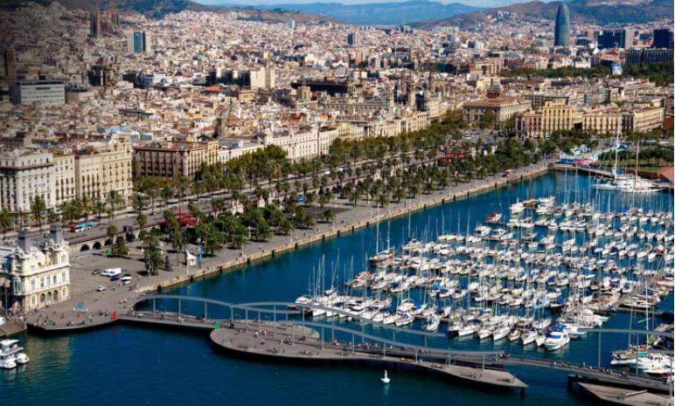
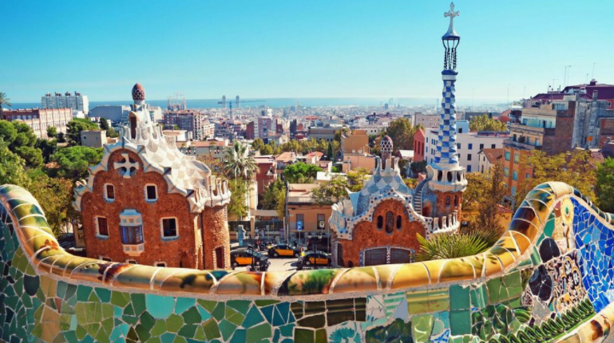
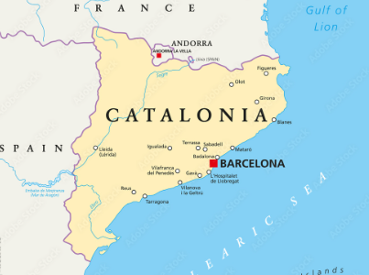
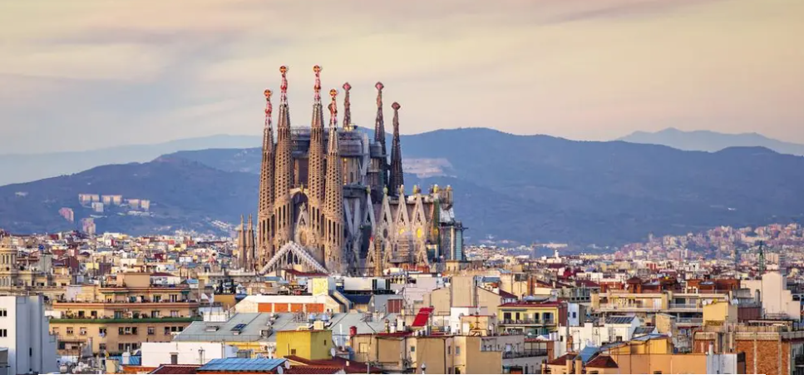
Catalonia Knowledge Organiser
The capital of Spain is Madrid.
Key Vocabulary
Catalonia - a region in Spain
Barcelona - the capital of Catalonia
Region - areas that are divided by physical characteristics and human
impact
Climate - the long term pattern of weather in a particular area
Climate Zone - areas with distinct climate
Mediterranean climate - warm wet winters and hot dry summers
Atlantic climate - mild winters and cool summers
Tourism - the study of travel as a social and cultural activity
Agriculture - farming, growing crops and rearing animals
Trade - a transaction or exchange of goods or services
Migration - the movement of people from place to place
Human Geography - human activity affecting or influencing the Earth
Physical Geography - looking at the Earth’s seasons, climate, soil,
atmosphere, rivers, oceans and landforms
Physical features
Large coastline
Mountain ranges
River Maya
4 provinces
Human features
Tourist attractions in Barcelona
Agriculture in Almeria
Finance and businesses in Madrid
Catalonia is a region in Spain.
Different parts
of Spain have
different
ecosystems
and climates.
Madrid is known Almeria is known Barcelona is known
for finance. for agriculture. for tourism.
Barcelona is the capital of Catalonia and is the birthplace of the architect Antoni Gaudi. He was inspired by the traditional architecture of Spain which was influenced by many invasions over time.
Barcelona is home to many of his buildings including the world famous Sagrada Familia Basilica. Millions of visitors travel to see this building every year so his work is very important to tourism in Catalonia.
Barcelona is the capital of Catalonia.

