Slide 1

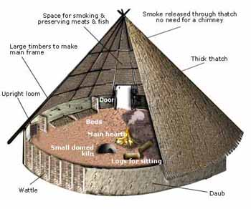
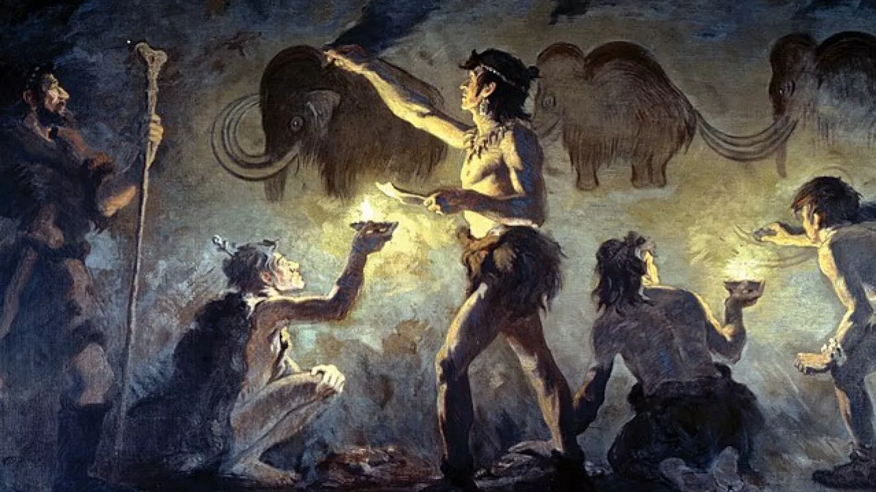
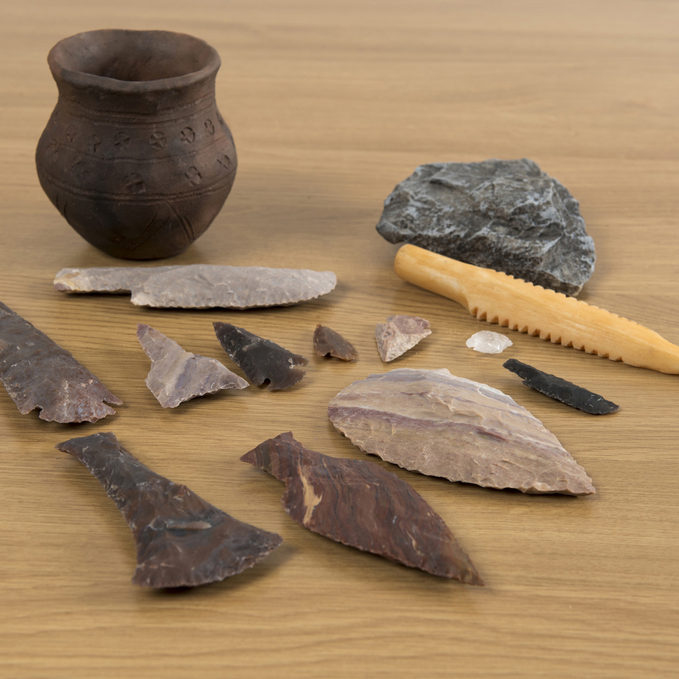
Stone Age to Iron Age
The Stone Age started around 2.5million BC. The Stone Age was called this because people use stone for weapons and tools.
During the early Stone Age people were hunter-gatherers.
During the early Stone Age people were nomads.
Farming started during the Neolithic time.
Skara Brae was a neolithic site found in Orkney.
Stonehenge is a famous neolithic monument found in Wiltshire, South England.
The Bronze Age started after the Stone Age.
Metal starts to be used at the beginning of the bronze age.
The Bronze Age is when people started to make tools out of bronze.
The Iron Age followed the Bronze Age.
The Iron Age is when people started making tools from Iron.
During the Iron Age the houses were gathered in communities on hills called ‘Hillforts’.
Druids were priests of the Celts. The Celts were one of the most powerful tribes in the Iron Age.
The Iron Age ended in AD43 when the Romans invaded.
Tier 2
bronze: copper and tin are melted together to make a metal called bronze
century: a period of 100 years
gather: collect things together
migration: movement from one place to another in order to settle there
sacrifice: offerings to spirits such as weapons, animals and humans
settler: People who migrate to a new place
settlement: When people start a community, this is a settlement
trade: the activity of buying, selling, or exchanging goods or services
remains: traces of the past
nomads: People who go from place to place with no permanent home.
extinct: When a species of animal no longer exists it is extinct.
Tier 3
druids: powerful religious people.
Paleolithic: Earliest period of the Stone Age.
Mesolithic: Middle period of the Stone Age.
Neolithic: Last period of the Stone Age.
neanderthal: A species of human that lived during prehistoric times.

Slide 2
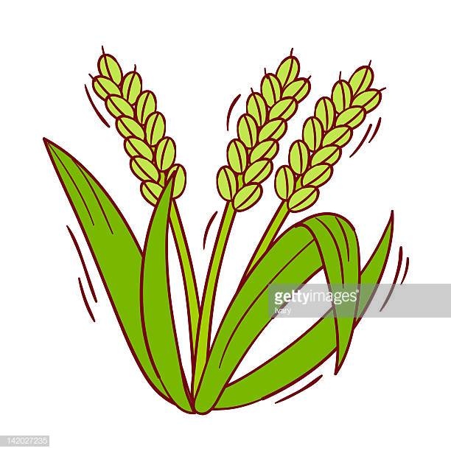
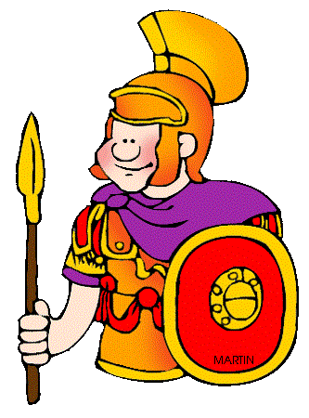
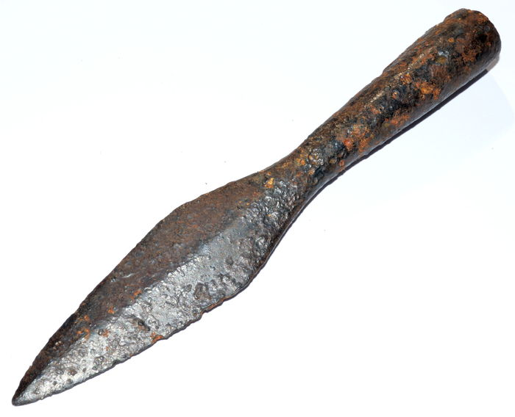
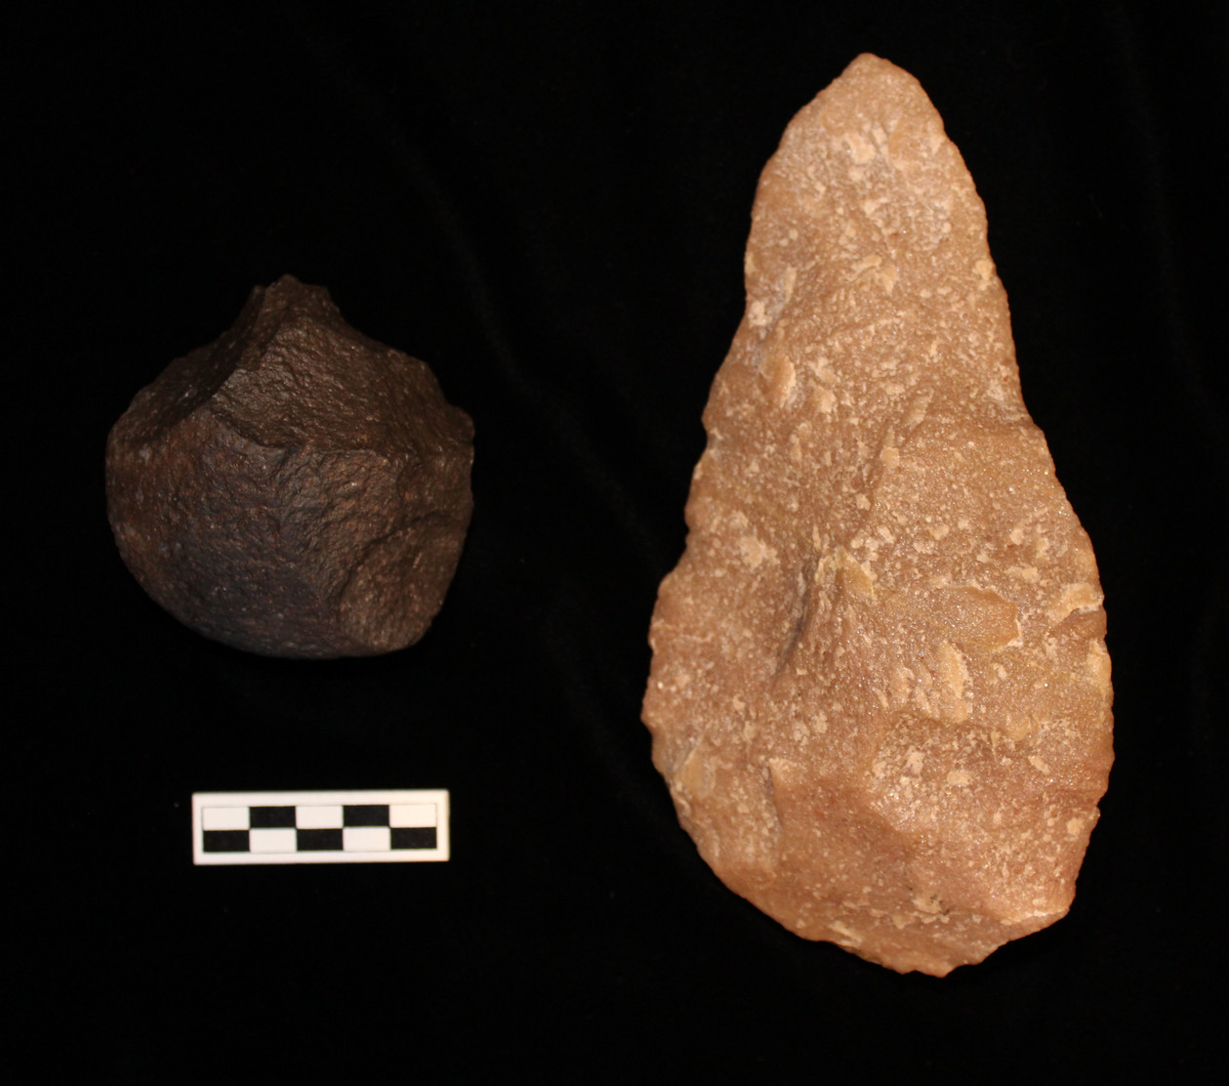

 | End of Topic
When did the Stone Age start?
Which year did the Iron Age end?
Which people came to Britain at the end of the Iron Age?
Why was the Stone Age called the Stone Age?
Why was the Iron Age called the Iron Age?
Which famous British monument was built during the Stone Age?
What did people make their homes out of during Stone Age times?
Which foods would people have eaten in stone and Iron age Britain? (tick or cross). | End of Topic
Spaghetti
Mussels
Nuts
Apples
Mashed potato
Deer meat
Put the events below on the timeline in order.
A People started farming in Britain
B Romans came to Britain
C People started to make things out of metal
D People started to make tools out of stone
10,000BC
5,000BC
0AD

Slide 3
 | Distance from Learning
When did the Stone Age start?
Which year did the Iron Age end?
Which people came to Britain at the end of the Iron Age?
Why was the Stone Age called the Stone Age?
Why was the Iron Age called the Iron Age?
Which famous British monument was built during the Stone Age?
What did people make their homes out of during Stone Age times?
Which foods would people have eaten in stone and Iron age Britain? (tick or cross). | Distance from Learning
Spaghetti
Mussels
Nuts
Apples
Mashed potato
Deer meat
Put the events below on the timeline in order.
People started farming in Britain
Romans came to Britain
People started to make things out of metal
People started to make tools out of stone
10,000BC
5,000BC
0AD

