Slide 1
Armley Park Primary
Year 3 2023
Miss Smith

Slide 2
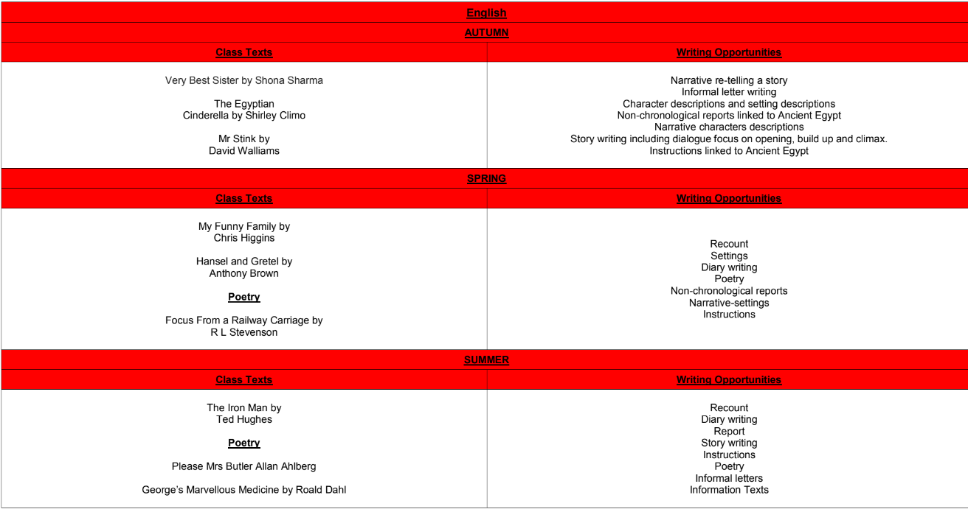
2023/2024 curriculum

Slide 3
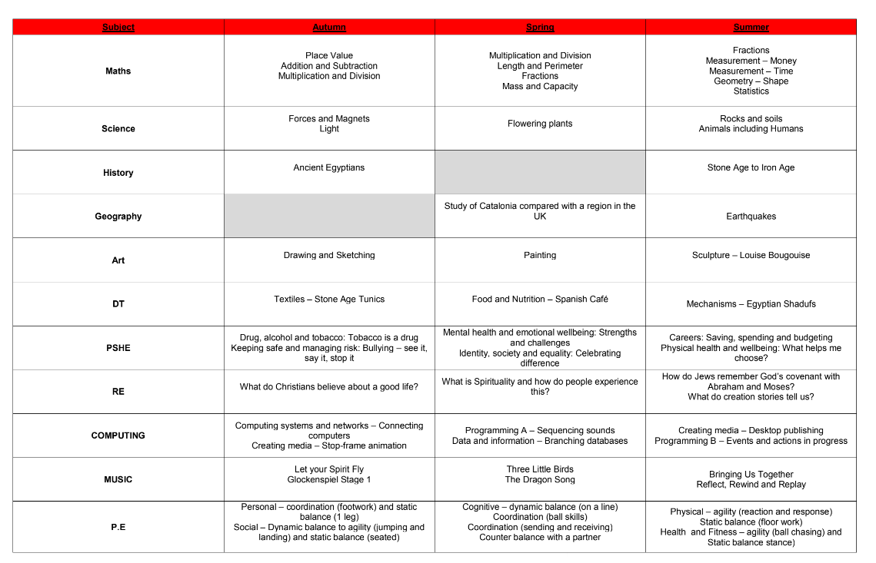

Slide 4
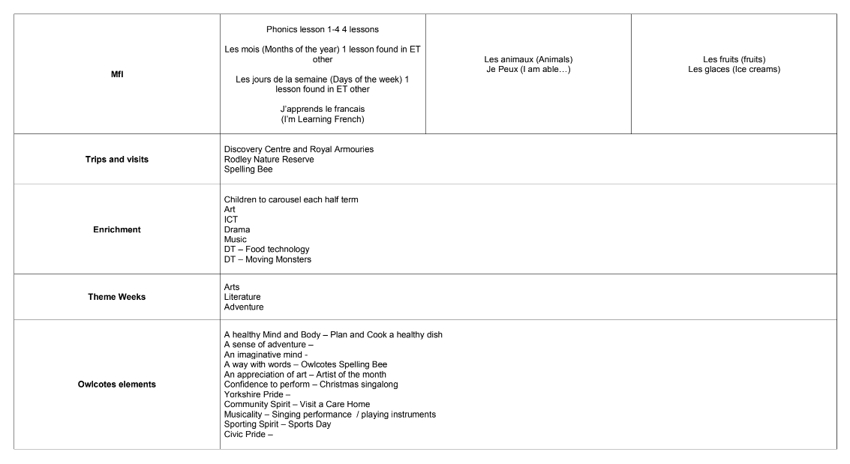

Slide 5
Behaviour policy
Rationale
At Armley Park Primary School we believe that good behaviour, discipline and mutual respect are essential
for the effectiveness of teaching and learning. Our expectations are that all adults will promote and reward
positive behaviours, but challenge unacceptable behaviours. We aim to create a culture where children
respect all adults whatever their role.
Aims
• To ensure that everyone feels safe, secure, valued, cared for and happy.
• To establish high expectations of behaviour and discipline agreed, supported and consistently
reinforced by all.
• To promote respect and tolerance.
• To encourage independence and self-discipline.
• To develop a partnership between home and school to support and share our aims.
We model this through using encouragement, praise and rewards for good behaviour.
Our behaviour system-class Dojo.

Slide 6
Home learning
Reading
Mathletics
Real Life experiences and opportunities to apply knowledge learnt.

